Slide 1
GIS Standards and Interoperability: Understanding and Using GML
David Arctur, PhD (ESRI)
Co-chair, OGC Simple Features Revision Working Group
Co-chair, OGC GML-SF Revision Working Group
Co-chair, OGC Web Feature Service Working Group

Slide 2
Geospatial Data Exchange Today
Today there are a number of approaches, sometimes called design patterns, for accomplishing geospatial data exchange between dissimilar systems
  File based approach: geographic data is encoded in a structured file format, for batch transfer or download
  Application programming interface (API) approach: geographic data is accessed and exchanged as needed between software systems on the same workstation, often interactively with the user
  Web services approach: geographic data is accessed and exchanged over networks and the Internet between software components, using http and other web based protocols
Notes:
These three approaches based on structured files, APIs, and web services, are all in current and growing use; each has advantages and disadvantages depending on the situation at hand.

Slide 3
Geospatial Data Exchange Standards
Geography Markup Language (GML) has its roots in decades-old geo-data exchange standards
  US Geological Survey’s Digital Line Graph (DLG)
  US Spatial Data Transfer Standard (SDTS)
  Canada’s Spatial Archive and Interchange Format (SAIF)
  …and many others
These have all been developed to solve the problem of packaging geospatial data in a file format independent of any GIS vendor’s software

Slide 4
Geographical Markup Language (GML)
GML is an Extensible Markup Language (XML) based encoding standard for geographic information, and was developed by the Open Geospatial Consortium (OGC).
Defines an XML schema for representing geographic features (attributes, geometries, relationships, etc).
GML Objects can represent:
Features | Coverages | Geometries
Topologies | Observations | Values
Coordinate Referencing | Styles | Dynamic Features, …

Slide 5
GML and XML
Because GML is based on XML, it leverages a wealth of standards, tools and practices for data exchange being developed by several consortia around the world
Standard XML technologies exist…
  for encoding and data modeling expression (DTD, RDF and XSD)
  for linking and associating resources (XLink)
  for selecting and pointing (XPath, XPointer)
  for transforming content (XSLT)
  for graphical rendering (SVG, VML, X3D)
Notes:
Obvious choice for GML to be built on XML …. So that it can piggy-back on these related technologies.

Slide 6
GML Evolution
ESRI presently implements GML 2.1.2
  Simple geometry model
  (points, lines, polygons with linear interpolation)
Moving to GML 3
  GML 3.x = 2.x + temporality + coordinate reference systems + units of measure + coverages + non-linear geometries + topology + …)
But GML 3 defines several complex entities such as topologies, dynamic features, and nested features, and these entities have many optional aspects. This impacts the way GML consumers would process a data exchange, as well as the potential for achieving interoperability.
Notes:
Early versions of GML – ESRI GML Profile – WFS in ArcIMS 4.0.1
Editorial Comment – GML not evil, just not workable unless well defined and well constrained…
Simple Feature GML maks it well defined and more portable
People can use GML to design/implement their own “proprietary” data format. Uses GML constructs, but needs quite a bit of effort to encode/decode reliably.

Slide 7
Schemas and Profiles: Harnessing the functionality in GML
GML Core Schema (Developed by OGC)
  Features, coverages, observations & measures
  Geometry, coordinate reference system
  Metadata, other common geospatial constructs
  Rules for extending GML schemas
GML Profiles (OGC)
  Selected subset of elements from GML
  Current: Point Profile, Simple Features Profile,
  GML in JPEG2000
  Future: Feature Profile, Grid Coverage Profile, CRS Profile, …
Application Schemas (Domain users)
  Data models for common application domains, built on GML core schema and profiles
  Transportation model; Hydrographic model; Land information model

Slide 8
GML Simple Features (GML-SF) Profile
Profile defines a prescribed subset of GML 3
Simple, “fixed” schema (no dynamic or nested features)
Simple geometry (point, linestring, polygon, aggregates)
Dynamic enumerations ok
No topology
…
Notes:
Especially from a WFS context

Slide 9
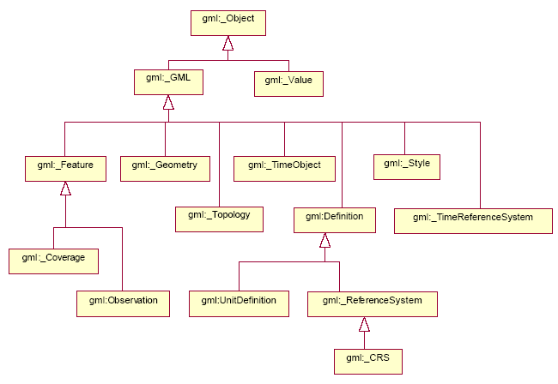
GML Class Hierarchy

Slide 10
GML Simple Features Profile:
Why Needed?
Initially motivated to help WFS’ use of GML 3
GML 3 enables dynamic creation of application schema, which complicates GML parsers
GML SF Profile “fixes” application schemas to only allow the elements prescribed in the profile
This allows WFS servers and clients to be more efficient; the types of data which they need to anticipate are finite and reasonably structured for fast parsing

Slide 11
GML Simple Features Profile:
Why Needed (cont’d)
Can be the basis for users’ application schemas
  As long as the schema elements required for the data model are defined within the GML-SF Profile
The geometry model will be coordinated with SQL/MM spec development now underway at ISO

Slide 12
GML Simple Features Profile:
Recent Progress
GML-SF started out as GML 3 Level 0 in 2003
  GML 2 was already “GML for Simple Features”
Extra push to complete this as a Simple Features Profile of GML 3, starting in Jan’05
  Fixed schema
  3D coordinates
  Simple geometry (points, lines, polygons, multipart)
  Dynamic codelists (eg, coded value domain lists)
  Reference links (can href to other resources, eg, for handling foreign/primary keys)
  Metadata links (can href to metadata)

Slide 13
GML-SF: Compliance Levels
SF-2 : essentially same as OGC SF [SQL, COM, CORBA]
    Restricted set of geometry property types
    No restrictions on non-spatial properties, except for parts of GML that have been deprecated
SF-1 : same as SF-2 with the following restrictions:
    Allows user-defined types for non-spatial properties
    User-defined types must use simple data types specified in this profile
SF-0 : same as SF-1 with the following restrictions:
    Allows only simple data types specified in this profile
    Cardinality of property values can be at most 1
    NOTE: in practice, this is the most interoperable, and follows the practice of most implementers of original OGC Simple Features spec.

Slide 14
GML-SF: Supported Geometries
Point, Multipoint
  2D or 3D points
Curve, Multicurve
  Linear interpolation between points
Surface, Multisurface
  Polygons with planar faces
Geometry, Multigeometry
  Potentially heterogeneous geometry collections (mixed point / line / polygon)

Slide 15
GML-SF Level 0: Basic Types
Properties (attributes) of features can only be simple types:
  Integer
  Real
  Character string
  Date
  Boolean
  Binary data
…plus these:
  URI references to local or remote resources
  An observation that includes a value and units of measurement
This list precludes features from having a property value that consists of another feature -- a concept called “nested features” which greatly complicates the schema
Feature collections cannot contain further collections (1 level deep)

Slide 16
GML-SF: Other Details
Coordinates may be 2D or 3D; just need to mention CRS once for a feature collection
This version of the profile does not include “measures” (m-values on coordinates) because GML 3.x does not explicitly mention measures; this will be pursued in the future
Supports dynamic codelists (sets of valid key- value pairs)
Can link to metadata and other resources via xlink:href

Slide 17
GML-SF: Summary
Some of these capabilities go beyond what has traditionally been called “Simple Features” but are still reasonably fixed in nature, and thus readily parseable by applications unaware of the schema a priori.
The three compliance levels reflect some vendors’ wishes to have flexibility, but this flexibility reduces the potential for interoperability.
GML-SF final draft is expected for review this week; expected to be formally adopted at next OGC meeting in March 2006.

Slide 18
ESRI Product Support for GML
ArcGIS 9.0 – Data Interoperability Extension
  GML Read / Write ( supports GML 2.x, 3.X, various application profiles )
  Web Feature Service (WFS) Client ( supports GML 2.1.2)
ArcIMS 9.0 – Data Delivery Extension
  Download Spatial Data ( supports GML 2.1.2 )
ArcIMS 9.1 – Web Feature Service (WFS) connector
  Streams Features as GML ( supports GML 2.1.2)

Slide 19
ArcGIS Data Interoperability Extension
Allows users to integrate many different spatial data formats into their GIS analysis directly.
Direct read for 65+ spatial data formats
Export of 50+ spatial data formats
Read / Write Support for GML formats include:
GML 2.x, Top10NL, OS(GB) MasterMap (GML 2), …
WFS Client Support for GML 2.1.2
Ability to diagram and model your own spatial data format
Ideal tool for consuming new GML application schemas.
Built by ESRI and Safe Software

Slide 20
Road Ahead - ESRI Planned Product Support for GML
Continue to Support new GML Profiles and Application Schemas
Provide out-of-the-box support for GML simple features profile

